Slide 1
Parallel Programming in Python – a very, very short introduction
Agenda
Computer architectures, data structures, and opportunities
Case 1 – computing the average of a very large sample
Case 2 – computing a sparse document/term matrix
Case 3 – computing a dense distance matrix

Slide 2
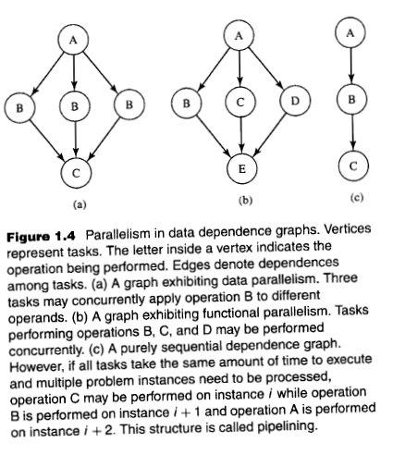
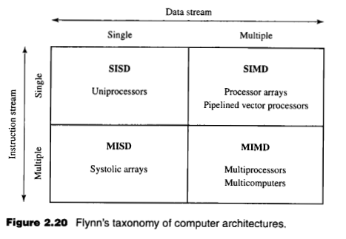
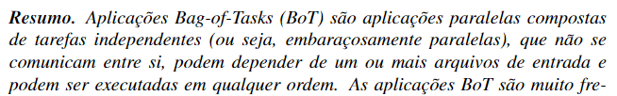


The scope of the technique that will be presented:

Slide 3

Case 1 – computing the average of a very large sample

Slide 4
Case 2 – computing a sparse document/term matrix

Slide 5
Case 3 – computing a dense distance matrix

Slide 6
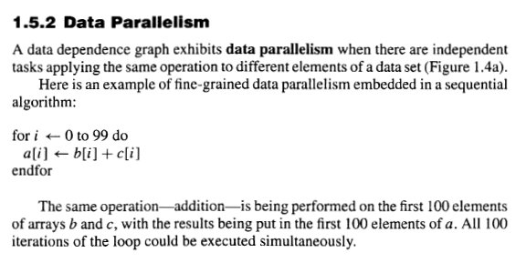
Bag of Tasks

Slide 7
